Slide 1
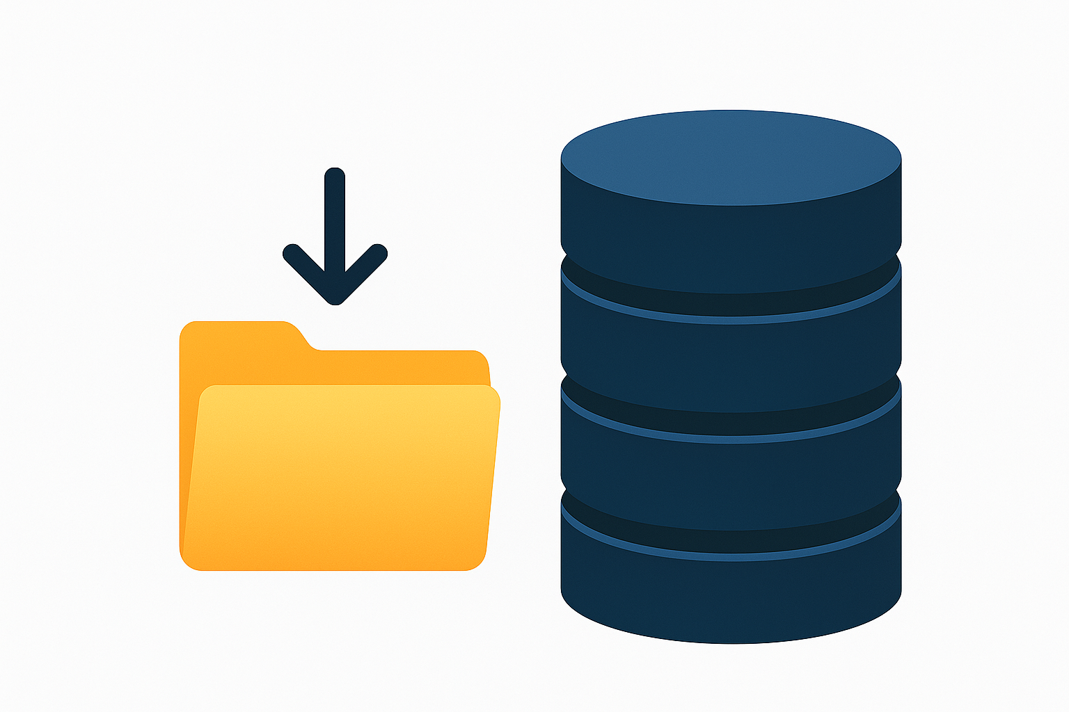
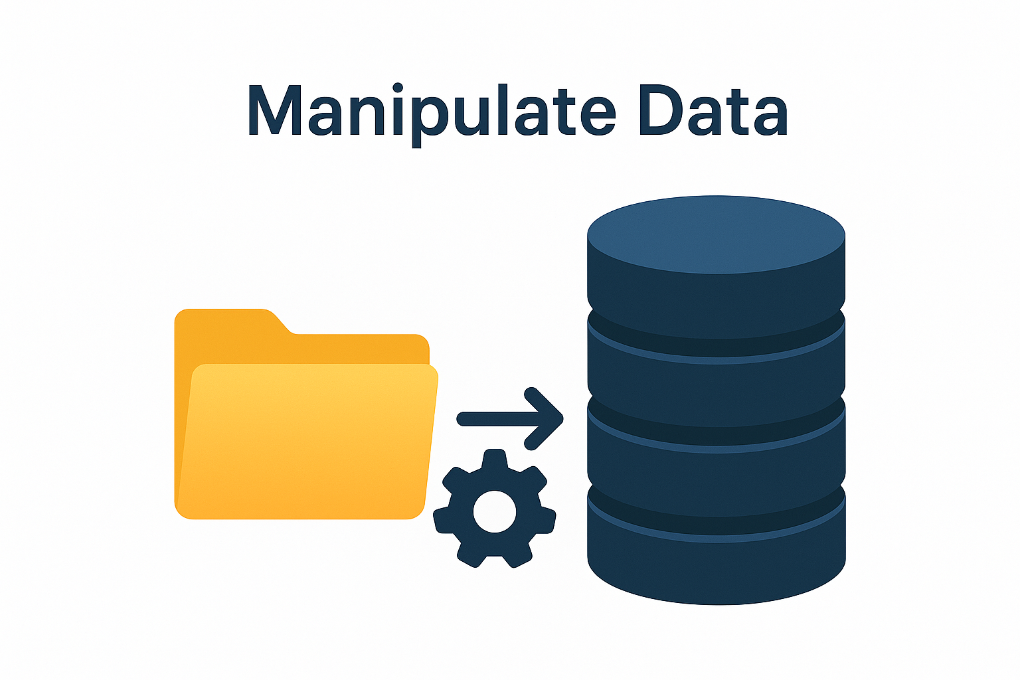
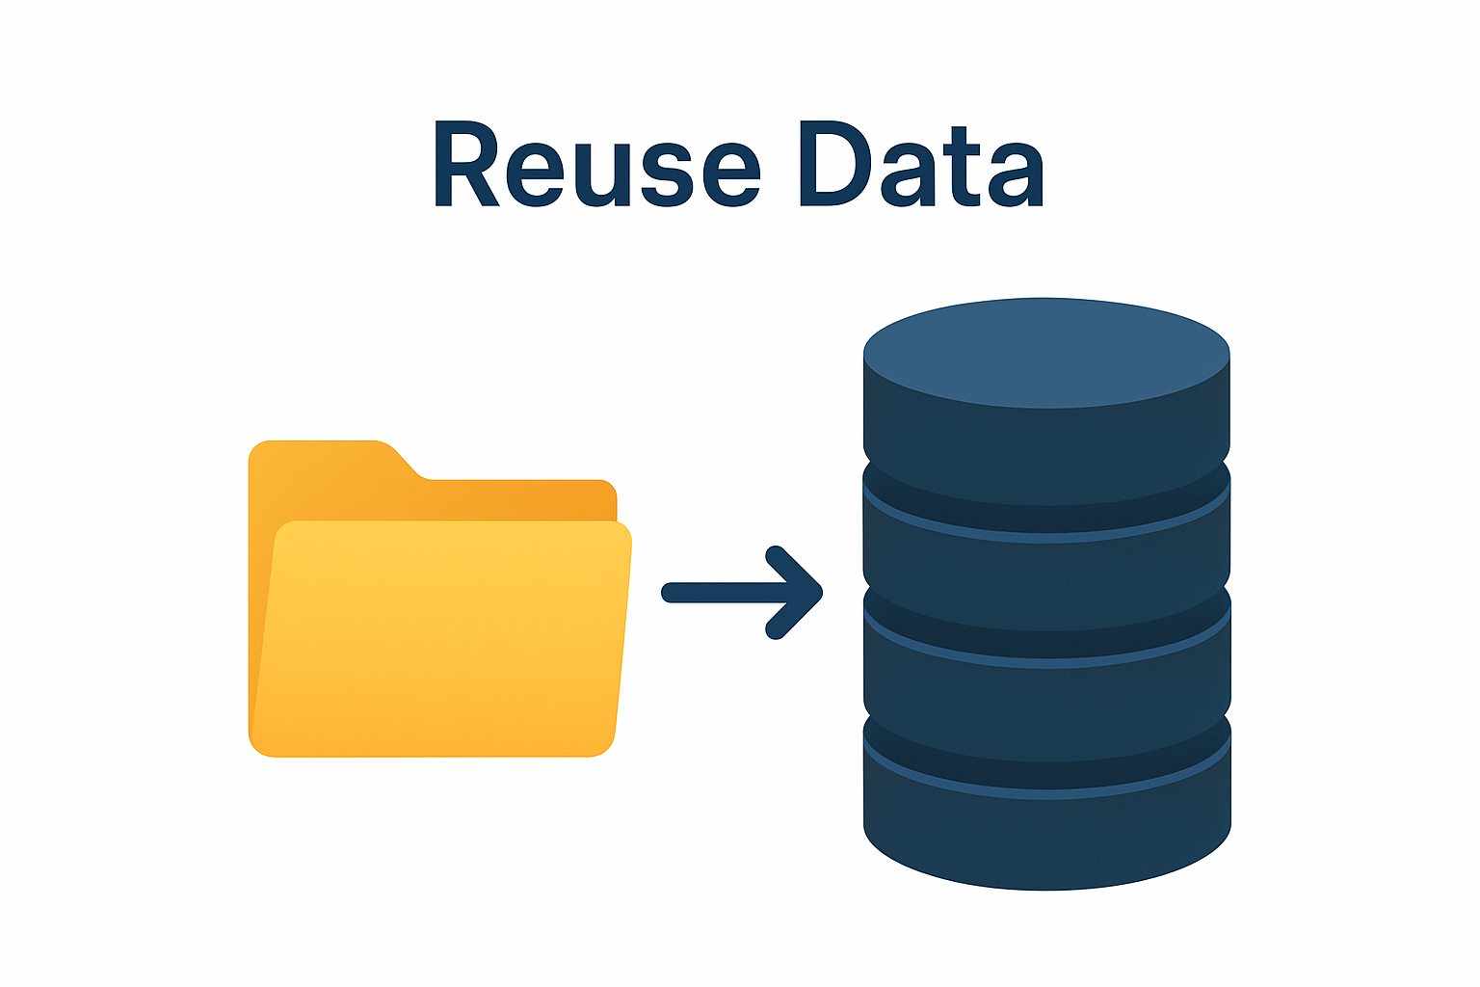
What Are Variables ?
Variables are memory objects that store data dynamically while workflows execute.
They enable robots to read, write, and pass information across different activities.
Purpose of Variables
Store Data
Manipulate Data
Rescue Data
Notes:
Instructor notes:
Briefly explain what automation is and its benefits to the participants. Give an example of automation.

Slide 2
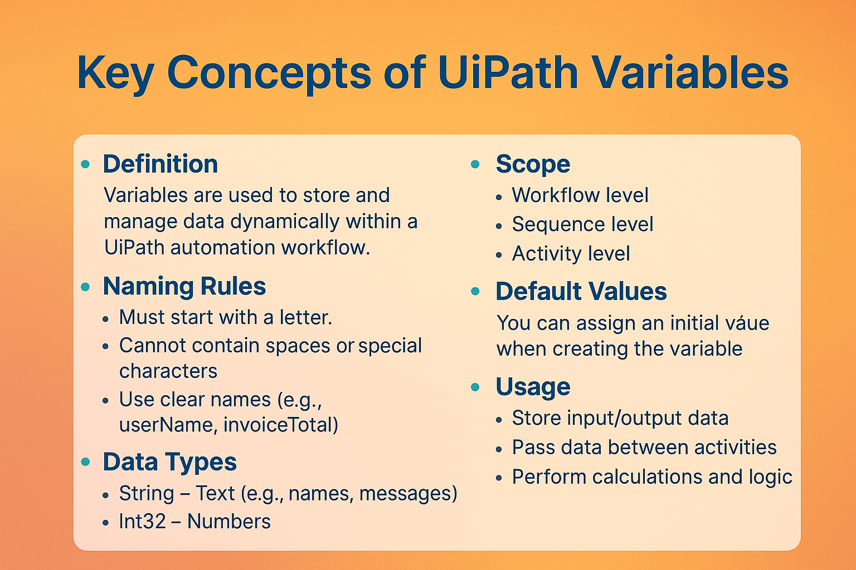
Key Concept of Variables
Notes:
Let’s start with what we have today and how we are making it better, Build-> Manage -> Execute automations
UiPath has been a great platform for your RPA developers to build and run automations for your business. And we have a lot coming in our 2019 release that they are going to love. (discuss 2019 highlights)

Slide 3
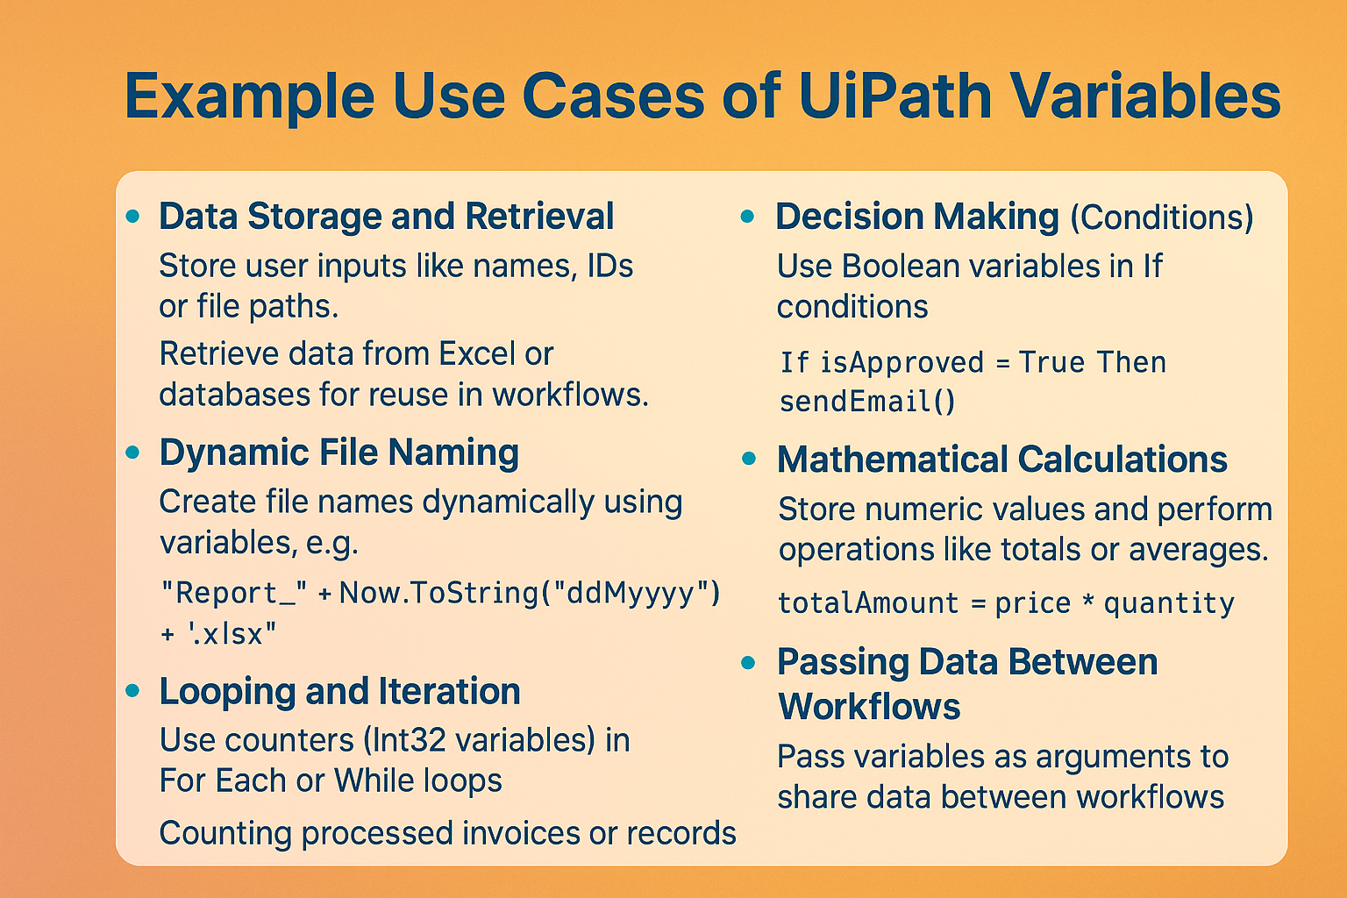
Notes:
Instructor notes:
Briefly explain what automation is and its benefits to the participants. Give an example of automation.

